Slide 1
Overview of climate configurations of the UM
Global Model Development & Science configuration
18/02/2016 by João Teixeira

Slide 2
Contents
What we will cover …
UM Global Model Development
GA / GO / GSI / GL / GC
Met Office Climate Model(s)
GC3 Components
What’s new
Climate Model Validation
Validation Notes
AutoAssess
GC3 Suite
Overview
Model output

Slide 3
UM Global Model Development
UM Science Configurations

Slide 4
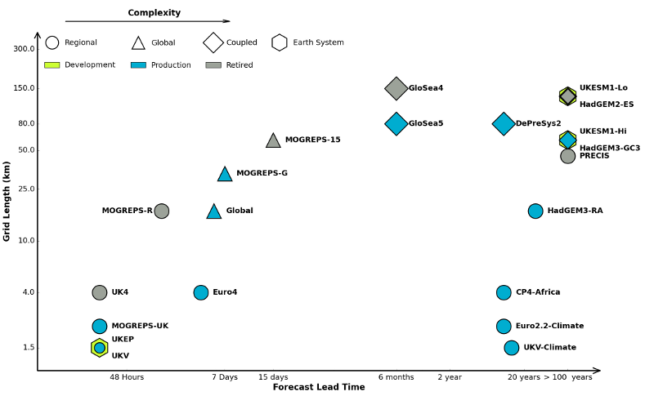
UM systems

Slide 5




Science Configurations
What’s out there?
UM – Atmosphere Science configuration (GA)
NEMO – Ocean Science configuration (GO)
Global Coupled
(GC)
CICE – Sea Ice Science configuration (GSI)
JULES – Land Science configuration (GL)

Slide 6
Science Configurations
Process design
Multi-year timescales
Annual release cycle
Model Development
Research Cycle
Implementation Cycle
Progress updates/review
PEGs/informal meetings
Research projects
Diagnostic studies
Process Evaluation Groups
Model Evaluation/Verification

Slide 7
Model Configurations
Science
Defines the model physics
A given configuration will run on more than one version of the model code
Independent of horizontal resolution
Components developed in partnerships with:
NERC
UM partners
NOC
NEMO dev group
Notes:
NOC = National Oceanography centre
NERC = Natural Environment Research Council

Slide 8
Met Office Hadley Centre
Climate Models
HadCM3
UK climate projections, Decadal forecasting (DePreSys),
IPCC AR3,4,5 (CMIP1,2,3,5), regional modelling (PRECIS)
First Model without Flux Correction
HadGEM1
IPCC AR4 (CMIP3)
HadGEM2
HadGEM2-A and –AO (IPCC AR5 (CMIP5)
HadGEM2-ES, -CC, -CCS full Earth system model (IPCC AR5 (CMIP5)
HadGEM3-GC2
New Ocean (NEMO) and Sea-ice (CICE) models
New Dynamical Core – End Game
UKESM1
Fully interactive earth system model based on HadGEM3-GC3
Contribution to CMIP6

Slide 9

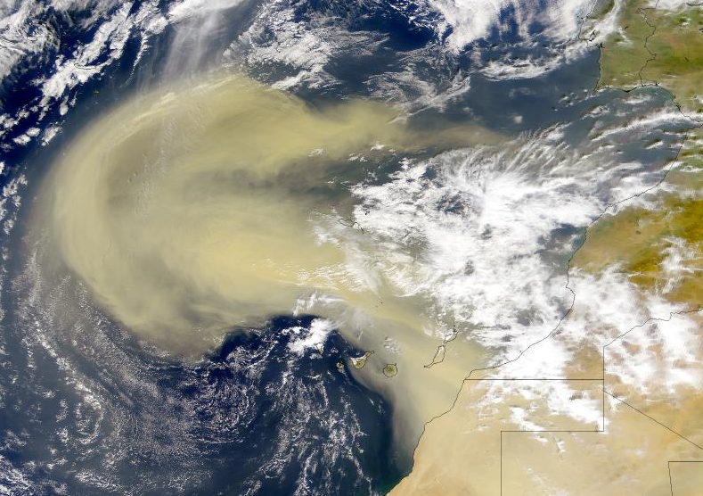
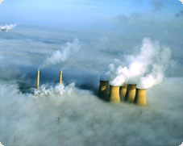
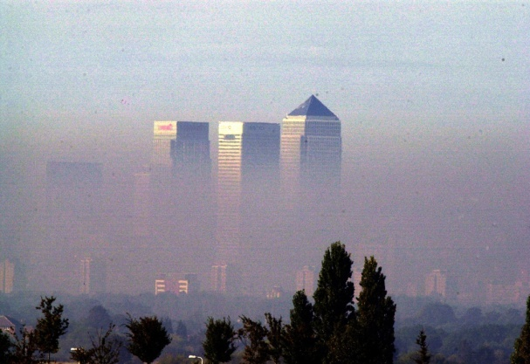
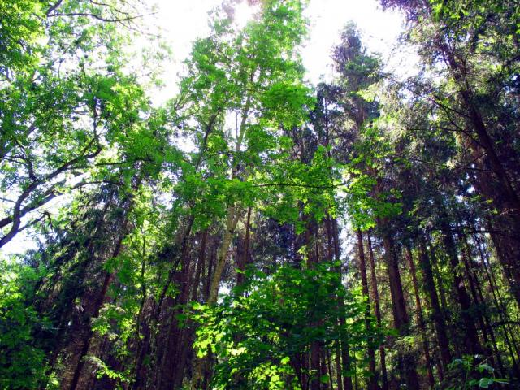
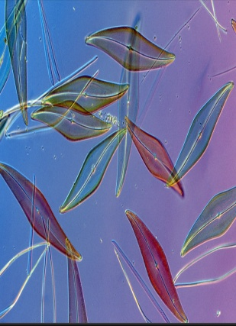
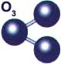
PHYSICAL CLIMATE
Radiation, cloud,
Greenhouse Effect
GREENHOUSE GASES
AEROSOLS
HadGEM2-ES
SO₄²⁻, formation
DMS, dust, emissions
Iron, deposition
CO₂,
CH₄, trop O₃
CHEMISTRY
(trop )
Wetland CH₄, dry deposition, stomatal uptake,
ECOSYSTEMS
C cycles
LAND
OCEAN

Slide 10
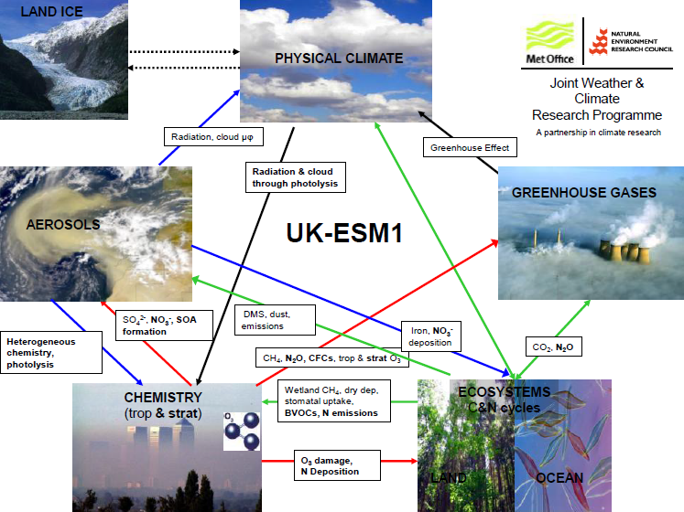

Slide 11
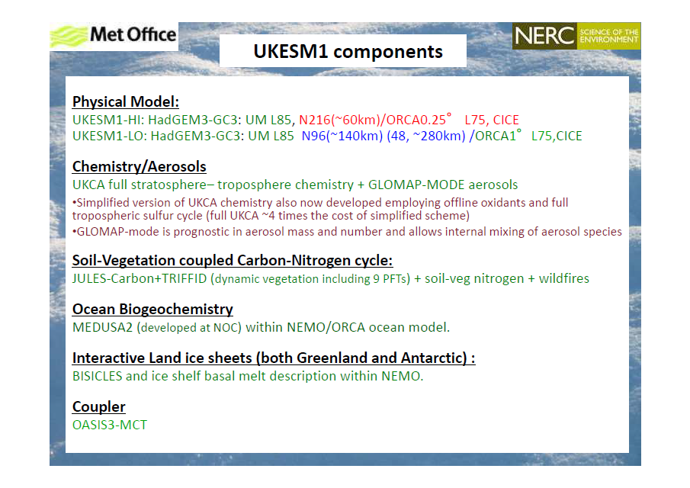

Slide 12
UM global atmosphere/coupled model configurations
N1024
12km
High resolution – being tested
Current Numerical Weather Prediction global resolution
N768
17km
N512
25km
UPSCALE project resolution
ORCA025
1/4°
Climate in development
N320
40km
Climate resolutions
Essentially the same physics/dynamics parameters used throughout model hierarchy
N216
60km
NEW Climate / GloSea5 resolution
ORCA025
1/4°
N144
90km
GloSea4 seasonal forecast resolution
N96
130km
ORCA1 1°
Atmosphere
Ocean/sea-ice

Slide 13
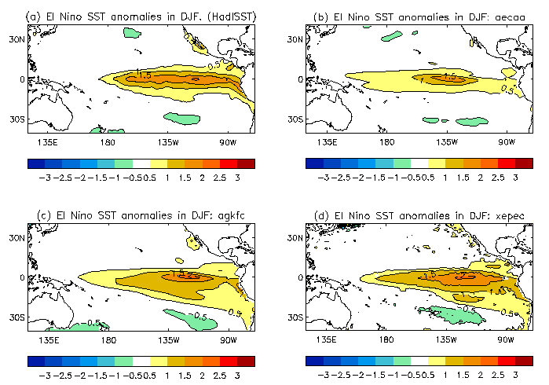
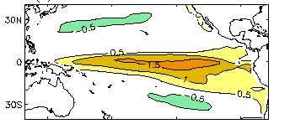
Benefits of higher spatial resolution
Obs
The westward extension of Nino is a common error in many climate models
Affects remote regions.
High-res model
Better ENSO pattern
Better teleconnections
Low resolution
High resolution

Slide 14
HadGEM3
The current climate modelling system
HadGEM3 has been under development for about 8 years
Two years ago, HadGEM3-GC2 was released and it used in a series of climate change experiments
HadGEM3-GC3 released in January 2016.
This will be converted to an Earth System model (+ carbon cycle and chemistry scheme) UKESM1 which will be used in CMIP6

Slide 15
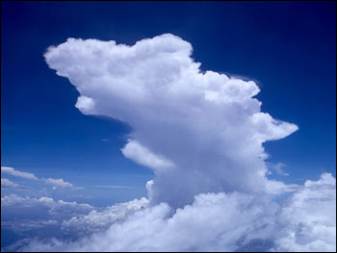
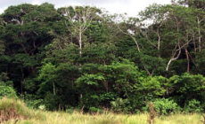
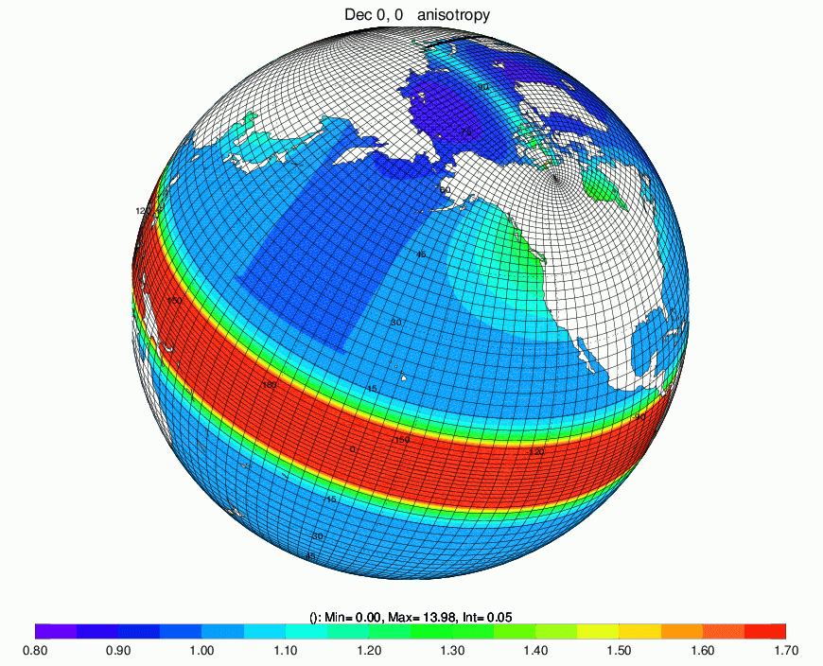

HadGEM3-GC3
JULES land surface GL7.0
(in collaboration with UK ac)
UM atmosphere GA7.0
Internal
communication
OASIS3-MCT
coupler
NEMO ocean model (GO6.0) made by a collaboration involving:
CNRS/IPSL (France)
Mercator Ocean (France)
NERC/NOCS (UK)
Met Office (UK)
CMCC (Italy)
INGV (Italy)
Internal
communication
CICE sea ice GSI8.0
made by Los Alamos National Laboratory (USA)

Slide 16
GC3 vs GC2
What’s new?
GA7.0
UKCA-MODE aerosols with offline oxidants
Improved updraught numerics in the 6a convection scheme
GL7.0
Implementation of the multilayer snow scheme
GO6.0
Code base upgraded to NEMO3.6_stable
ORCA025 extended further into Antarctica allowing modelling iceshelf cavities
Non linear free surface and variable volume layers (VVL)
GSI8.0 and GSI7.0
Multi layer sea ice: 4 ice layers & 1 snow layer
Inclusion of prognostic melt ponds
And more:
http://collab.metoffice.gov.uk/twiki/bin/view/Development/GCPackageTesting

Slide 17
GC3 vs GC2
What’s new?
The Coupler
OASIS3-MCT coupler (GC2.0 used standard OASIS3)
Hourly coupling (GC2.0 used 3 hourly coupling)
Second order regridding in selected fields
Icebergs fed from land ice
And more:
https://code.metoffice.gov.uk/trac/gmed/wiki/GCDev/GCDocumentation
Notes:
GC3.0 coupling changes on top of GC2.0 OASIS3-MCT coupler (GC2.0 used standard OASIS3): The MCT version of the coupler provides routines to be compiled with the atmosphere and ocean executables (standard OASIS3 made its own executable). This enables the code to be much more scalable with processors and resolution. It is also essential for UKESM1 as it provides 3D coupling not available in the standard version. Hourly coupling (GC2.0 used 3 hourly coupling): As the atmosphere and ocean models run in parallel there is a lag between the fluxes generated by the atmosphere to the time when the ocean experiences these fluxes. This lag is more evident in coupled NWP models and moving to hourly coupling reduces this lag and improves the forecasts. This has minimal effect on climate model climatologies but may impact the MJO. Second order regridding in selected fields: When the grids are markedly different (e.g. N96 and ORCA025) there is an imprint of the N96 grid seen in some ocean fields (e.g. ocean_vertical_momentum_diffusivity). By smoothing the data passed through the coupler this imprinting is reduced (although not removed). Only already relatively smooth fields can use second order regirdding as noisy fields are made more noisy. Therefore second order regridding is only turned on for evaporation, sublimation and net heat flux. Icebergs fed from land ice increases: Snow amounts on land ice gradually increase over time. In GC2.0 a blanket fresh water flux was applied to the extratropical oceans to balance this snow increase. In GC3.0 the snow amounts over land ice are passed though the coupler to NEMO's prognostic iceberg scheme and iceshelf melting scheme, maintaining water conservation.

Slide 18
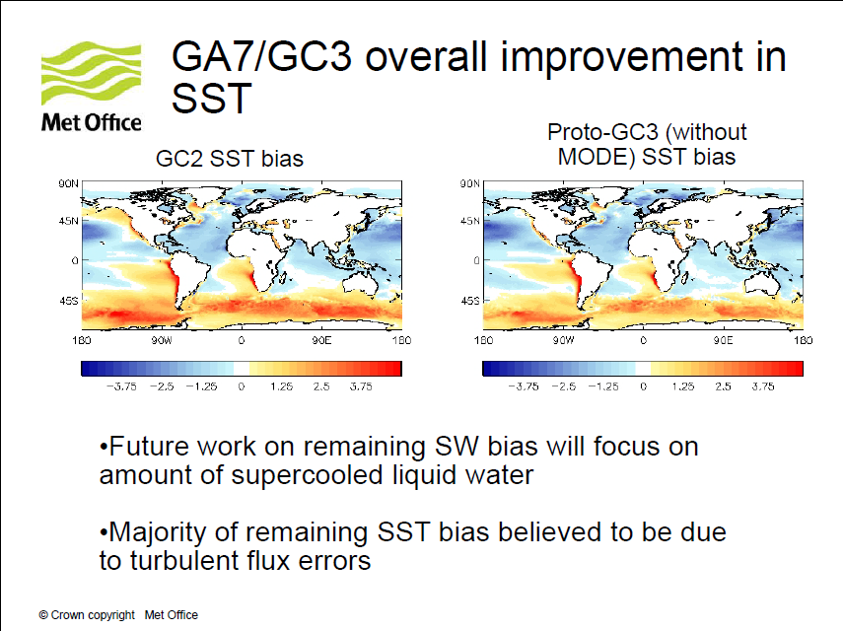

Slide 19
Climate Model Validation
Validation and Assessment

Slide 20
Validation Notes
Used for assessing the climatology of the model by comparing with observed climatologies.
Currently written in IDL using in-house routines but will soon be written in Python and be more portable for collaborators to use.

Slide 21
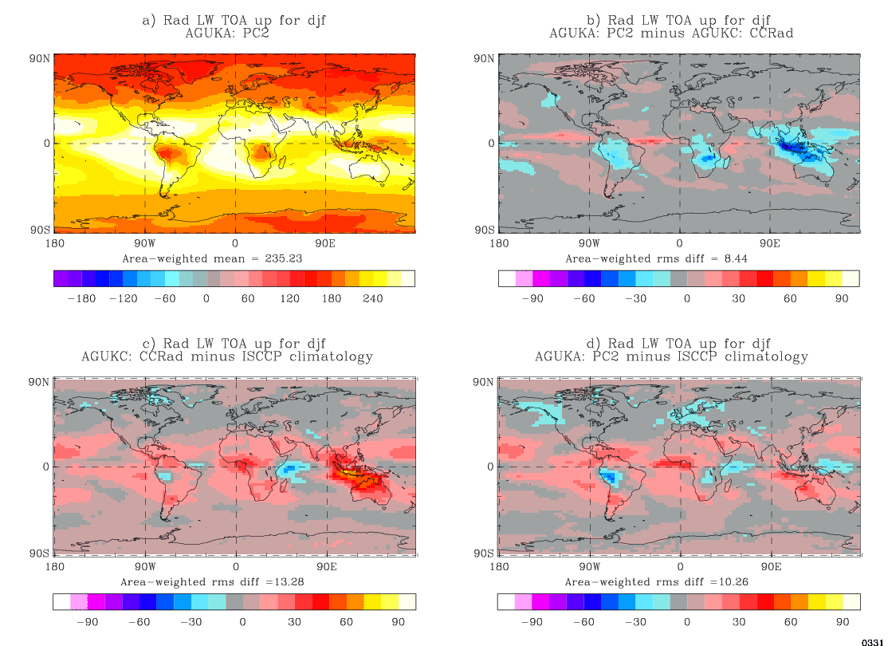
Validation Notes

Slide 22
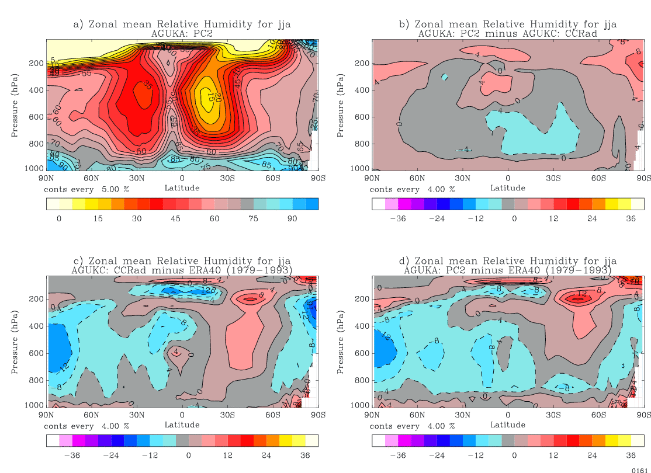
Validation Notes

Slide 23
AutoAssess
Normalised assessment plots
AutoAssess software is run on all major model runs and generates metrics of all important quantities (climatological means, modes of variability and accuracy of teleconnections).
AutoAssess generates normalised assessment plots that lets you see, at a glance, what metrics are improving and what metrics are degrading.

Slide 24
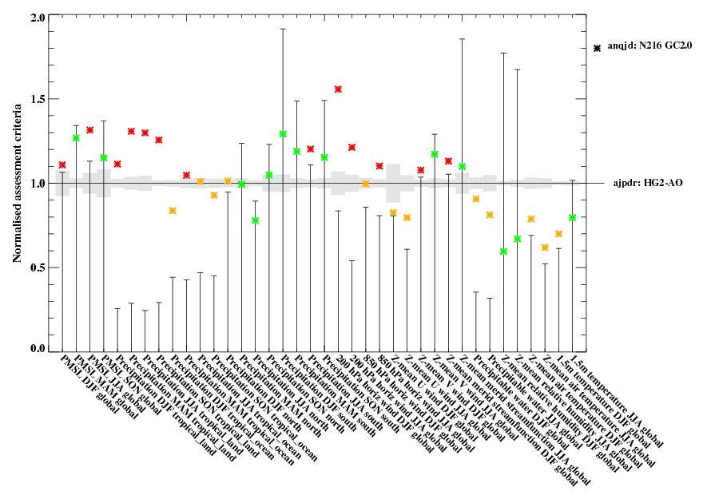
AutoAssess
Normalised assessment plots
GC2.0
HadGEM2

Slide 25
GC3 suite
What does it look like?

Slide 26
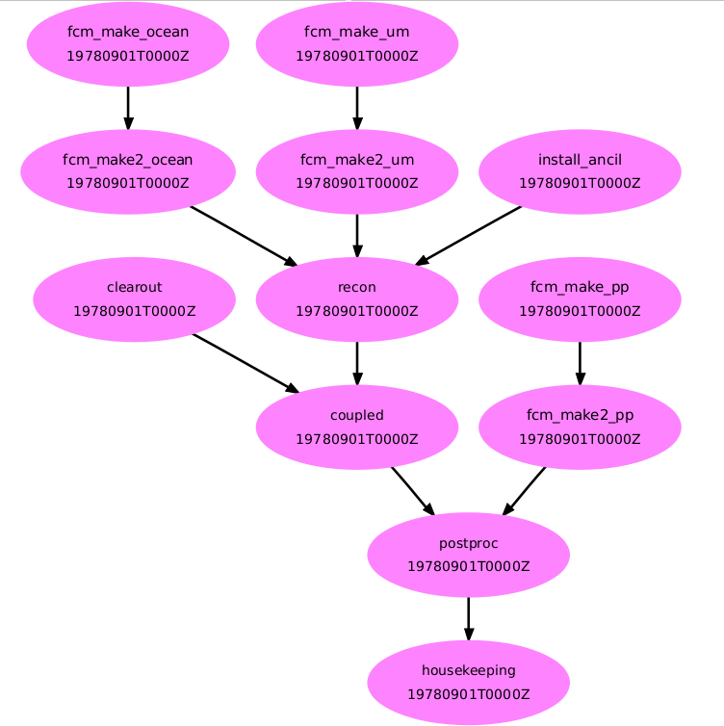
Standard Couple GC3
Lots of apps and tasks...

Slide 27
Standard Couple GC3
GC3 Components
Task | Description
fcm_make2_um | Will continue the fcm make command at a remote HOST
install_ancil | Installs the ancil file
fcm_make_pp | Build Archiving app
fcm_make2_ocean | Similar to fcm_make but for the ocean model
postproc | Archiving and deletion of dumps and pp files
housekeeping | Tidy logs and old working directories

Slide 28
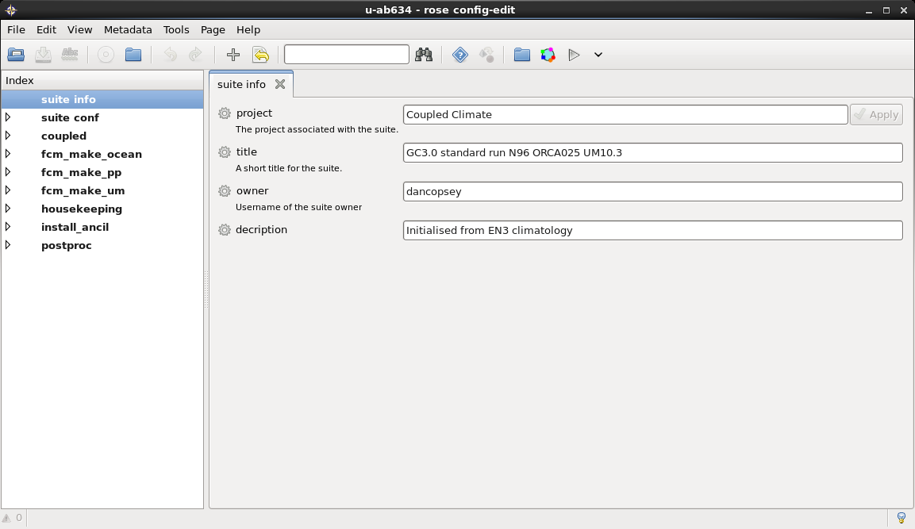
GC3 Rose suite
Differences from GA7 menus & contents

Slide 29
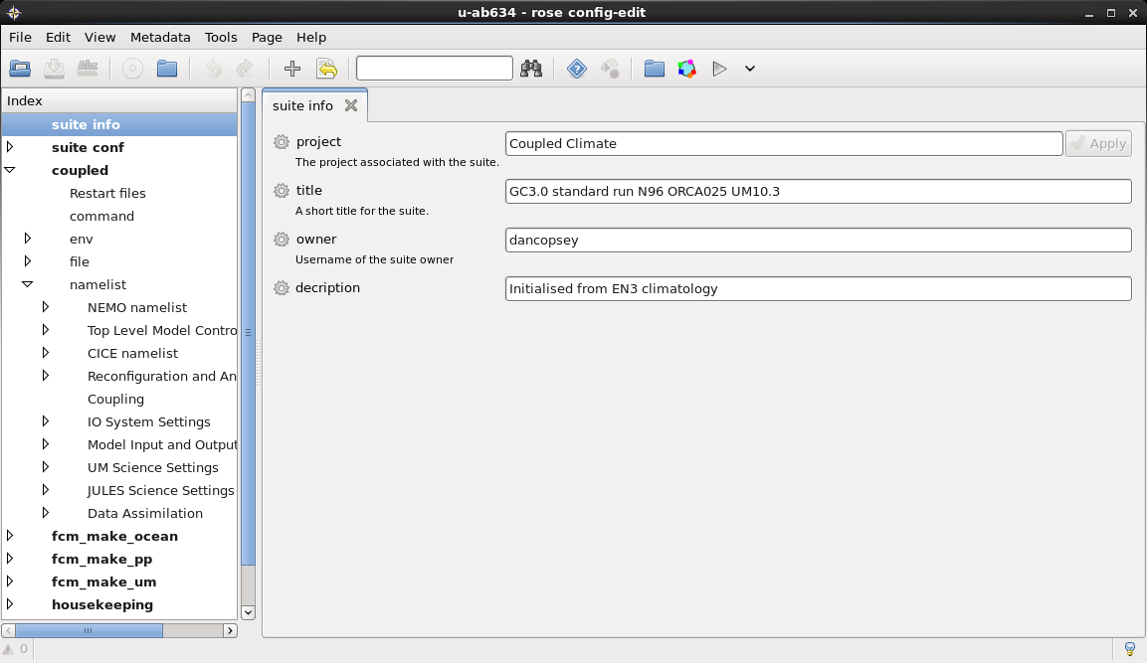
GC3 Rose suite
Differences from GA7 menus & contents
Includes all the namelists/ options for the science configuration of the models

Slide 30
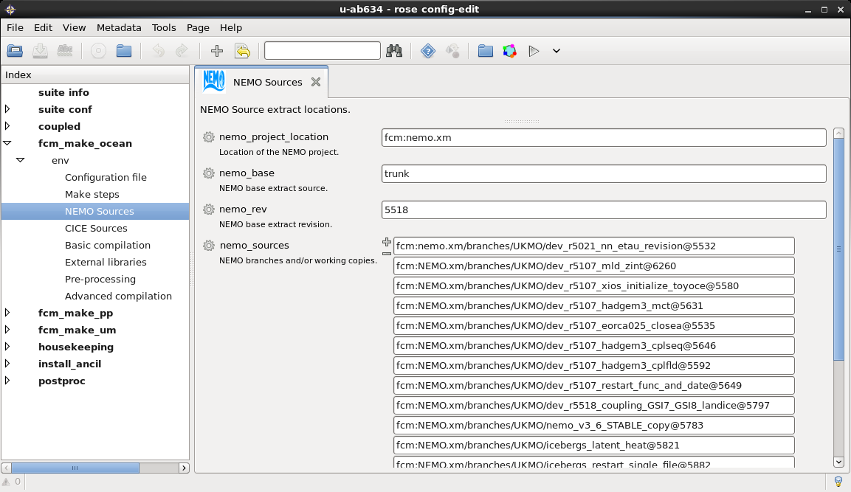
GC3 Rose suite
Differences from GA7 menus & contents

Slide 31
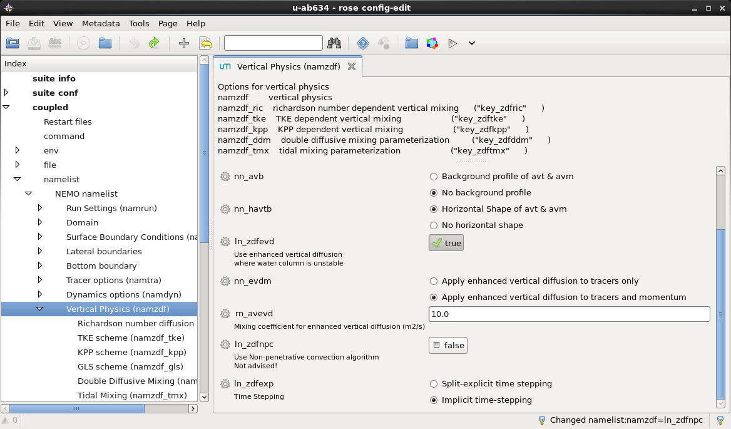
GC3 Rose suite
Info/Metadata/Triggers
Trigger ignored settings also available for the coupled models
Try activating ln_zdfnpc in the Nemo vertical physics namelist...

Slide 32



GC3 Output
Extra output streams for Ocean & Ice Postproc
UM & JULES
ap*.pp streams
(apm.pp, aps.pp, apy.pp )
pp file
NEMO
on*.nc.file streams
(onm.nc.file, ons.nc.file, ony.nc.file)
NetCDF
CICE
in*.nc.file streams
(inm.nc.file, ins.nc.file, iny.nc.file)
NetCDF

Slide 33







GC3 Suite
Dependencies & Porting
Pre-requisites
Flexible Configuration Management (FCM) (...or similar)
Rose and Rose utilities
Cylc
Access to :
the Met Office Science Repository (MOSRS)
the NEMO-code repository
TIDS group space on JASMIN
CICE Los Alamos Repository

Slide 34
GC3 Suite
Dependencies & Porting
The Rose Suite and Science configurations
u-ab634 – N96
u-ab635 – N216
MOSRS – rose suite for standard jobs
Necessary files (ancillaries, grids, startdumps, metadata)
/group_workspaces/jasmin2/tids/UM/
/group_workspaces/jasmin2/tids/OCEAN/
TIDS space on JASMIN

Slide 35
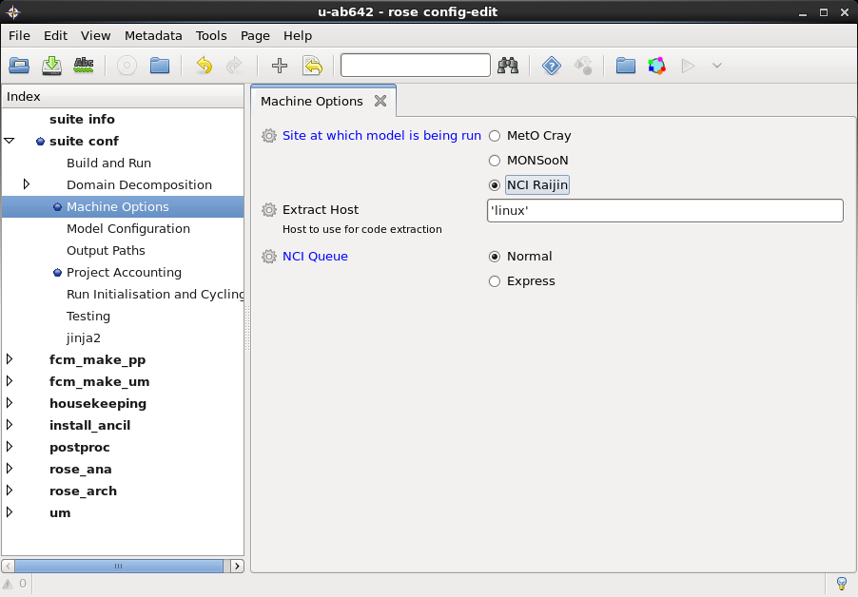
GC3 Suite
Dependencies & Porting
GC3 suites do not have a site configuration that you can choose from
Applies the site configuration to the suite.rc file
Uses site specific options (e.g queues)

Slide 36
GC3 Suite
Dependencies & Porting
GC3 suites do not have a site configuration that you can choose from
Useful documentation for porting
http://collab.metoffice.gov.uk/twiki/bin/view/Support/GC3InstructionsVN103N96
http://collab.metoffice.gov.uk/twiki/bin/view/Support/GC3InstructionsVN103N216

Slide 37

GC3 Suite
... Let’s try to run it!!!
Global Coupled is expensive to run...
We can run in simulation mode
rose suite-run -- --mode=simulation
Installs the suite on the cylc servers
Runs a sleep 5 bash command for each task
Almost the same as running ☺

Slide 38
GC3 vs GC2
What’s new?
GA7.0
UKCA-MODE aerosols with offline oxidants
Improved updraught numerics in the 6a convection scheme
GL7.0
Implementation of the multilayer snow scheme
GO6.0
Code base upgraded to NEMO3.6_stable
ORCA025 extended further into Antarctica allowing modelling iceshelf cavities
Non linear free surface and variable volume layers (VVL)
GSI8.0 and GSI7.0
Multi layer sea ice: 4 ice layers & 1 snow layer
Inclusion of prognostic melt ponds
But at what cost?

Slide 39
GC3 vs GC2
Cost...
How long does it take to run GC3?
GC2.0 ran at 2 years per day
both N96 using 19 nodes and N216 using 37 nodes
GC3.0 runs at 1.27 years per day for N96 using 22 nodes
1.09 years per day for N216 using 56 nodes
Main cause UKCA which takes a lot of extra compute power
Work is underway to speed up UKCA and some promising code changes are already being proposed.

Slide 40
Global Model Development
Docs and Info

Slide 41
Global Model Development
Development and Evaluation
Where can you find documentation?
Collaboration Wiki
http://collab.metoffice.gov.uk
General Documentation about the UM
UM support pages
-- Lots of links to other UM relevant pages
-- How to run and port configs
How to(s)
-- External access to MASS
-- And more
Static Web
-- A mirror to MO internal pages
Projects Pages
-- Lots of collaborative projects
Met Office Science Repository Service
https://code.metoffice.gov.uk/trac/gmed
Code repository
Ticket System
A Wiki with more documentation

Slide 42
Global Model Development
Development & Evaluation pages
Useful links for GMED
Documentation for frozen GC configurations
Documentation for frozen GA/GL configurations
Available Standard & Assessment Configurations
Clicking on a suite-ID will give you more info on the configuration
(including Validation Notes)
Tickets describing the changes were made
​GA7 / GC3 configuration documentation & assessment runs
​ List of atmospheric validation notes
... And much more

Slide 43
Useful links
Online documentations ...
UM Documentation
https://code.metoffice.gov.uk/doc/um/
http://collab.metoffice.gov.uk/twiki/bin/view/Support/UMarticles
http://collab.metoffice.gov.uk/twiki/bin/view/Support/UnifiedModel
Global Model Development
http://collab.metoffice.gov.uk/twiki/bin/view/Development/WebHome
https://code.metoffice.gov.uk/trac/gmed
https://code.metoffice.gov.uk/trac/GA/wiki/GADocumentation/GA7.0

Slide 44

Questions … ?
Coffee ?
20’ break ?

